Slide 1
FOUR ARTS

Slide 2
TO BE CALLED A REFINED GENTLEMAN
QIN---- GUQIN.. PLAY A STRINGED INSTRUMENT. (ANY)
QI. THE STRATEGY GAME
SHU– THE CALLIGRAPHY… WRITING AS AN ART FORM.
HUA.– THE PAINTING.

Slide 3
Quite Unlike the Western Models of
The Battle of Waterloo was won on the playing fields of Eton…
Contact sports.

Slide 4
UNIQUELY CHINESE GAMES

Slide 5
BROAD OBSERVATIONS
ABSTRACT STRATEGY.
FACE/ MIAN ZI ISSUES.
FLOW.
HAND EYE COORDINATION
BALANCE… YIN AND THE YANG.
NO CONTACT SPORTS.

Slide 6
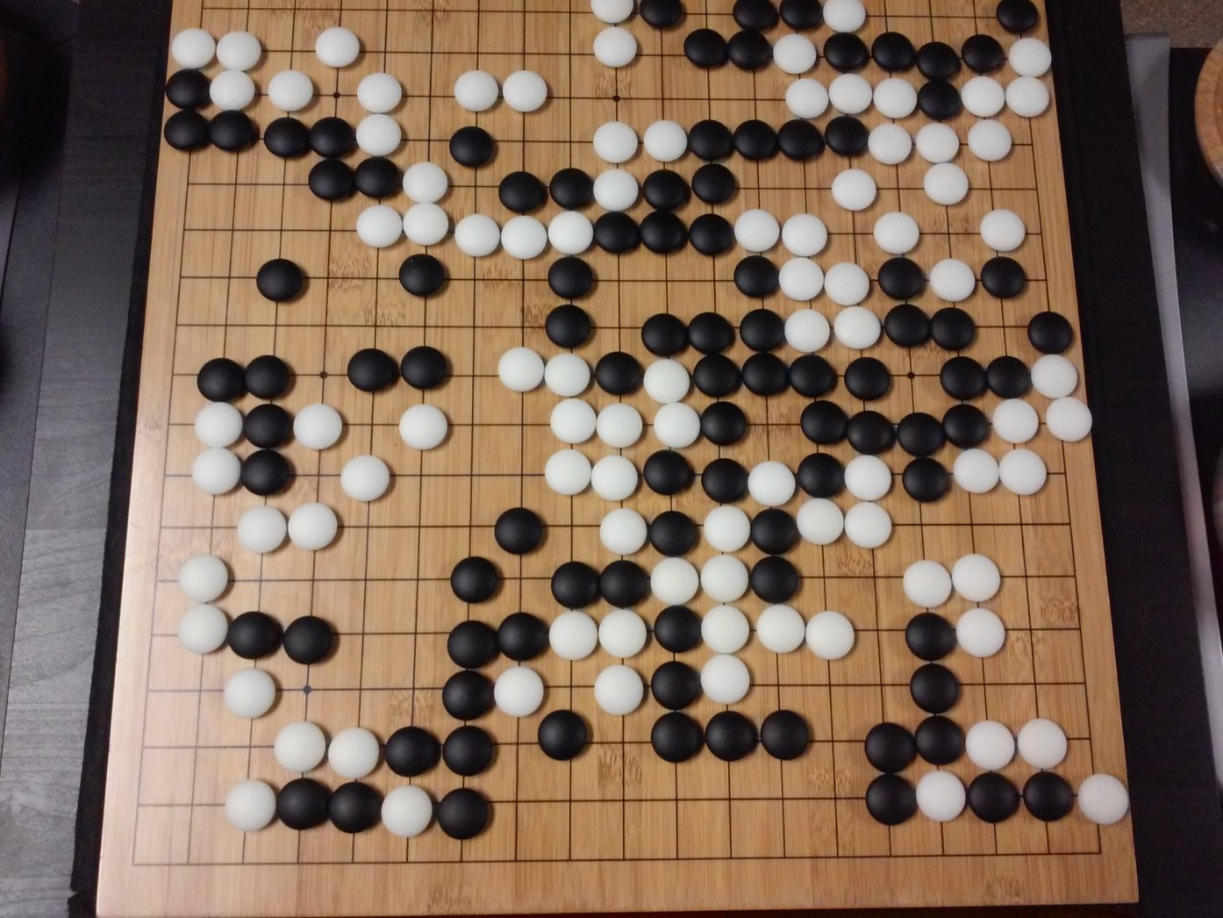

Slide 7
WEI QI/GO
ARISTOCRATIC.
ANCIENT, REFERRED TO IN ANALECTS.
The most famous (though not the oldest) go manual is the Xuanxuan Qijing, published in 1349 by Yan Defu and Yan Tianzhang.
PLACING BLACK AND WHITE STONES ON A GRID
19X19.
13X13
9X9
WINNER DECIDED BY TERRITORY COVERED.
EXTREMELY COMPLEX GAME. NO OF MOVES AT LEAST 2 × 10¹⁷⁰

Slide 8
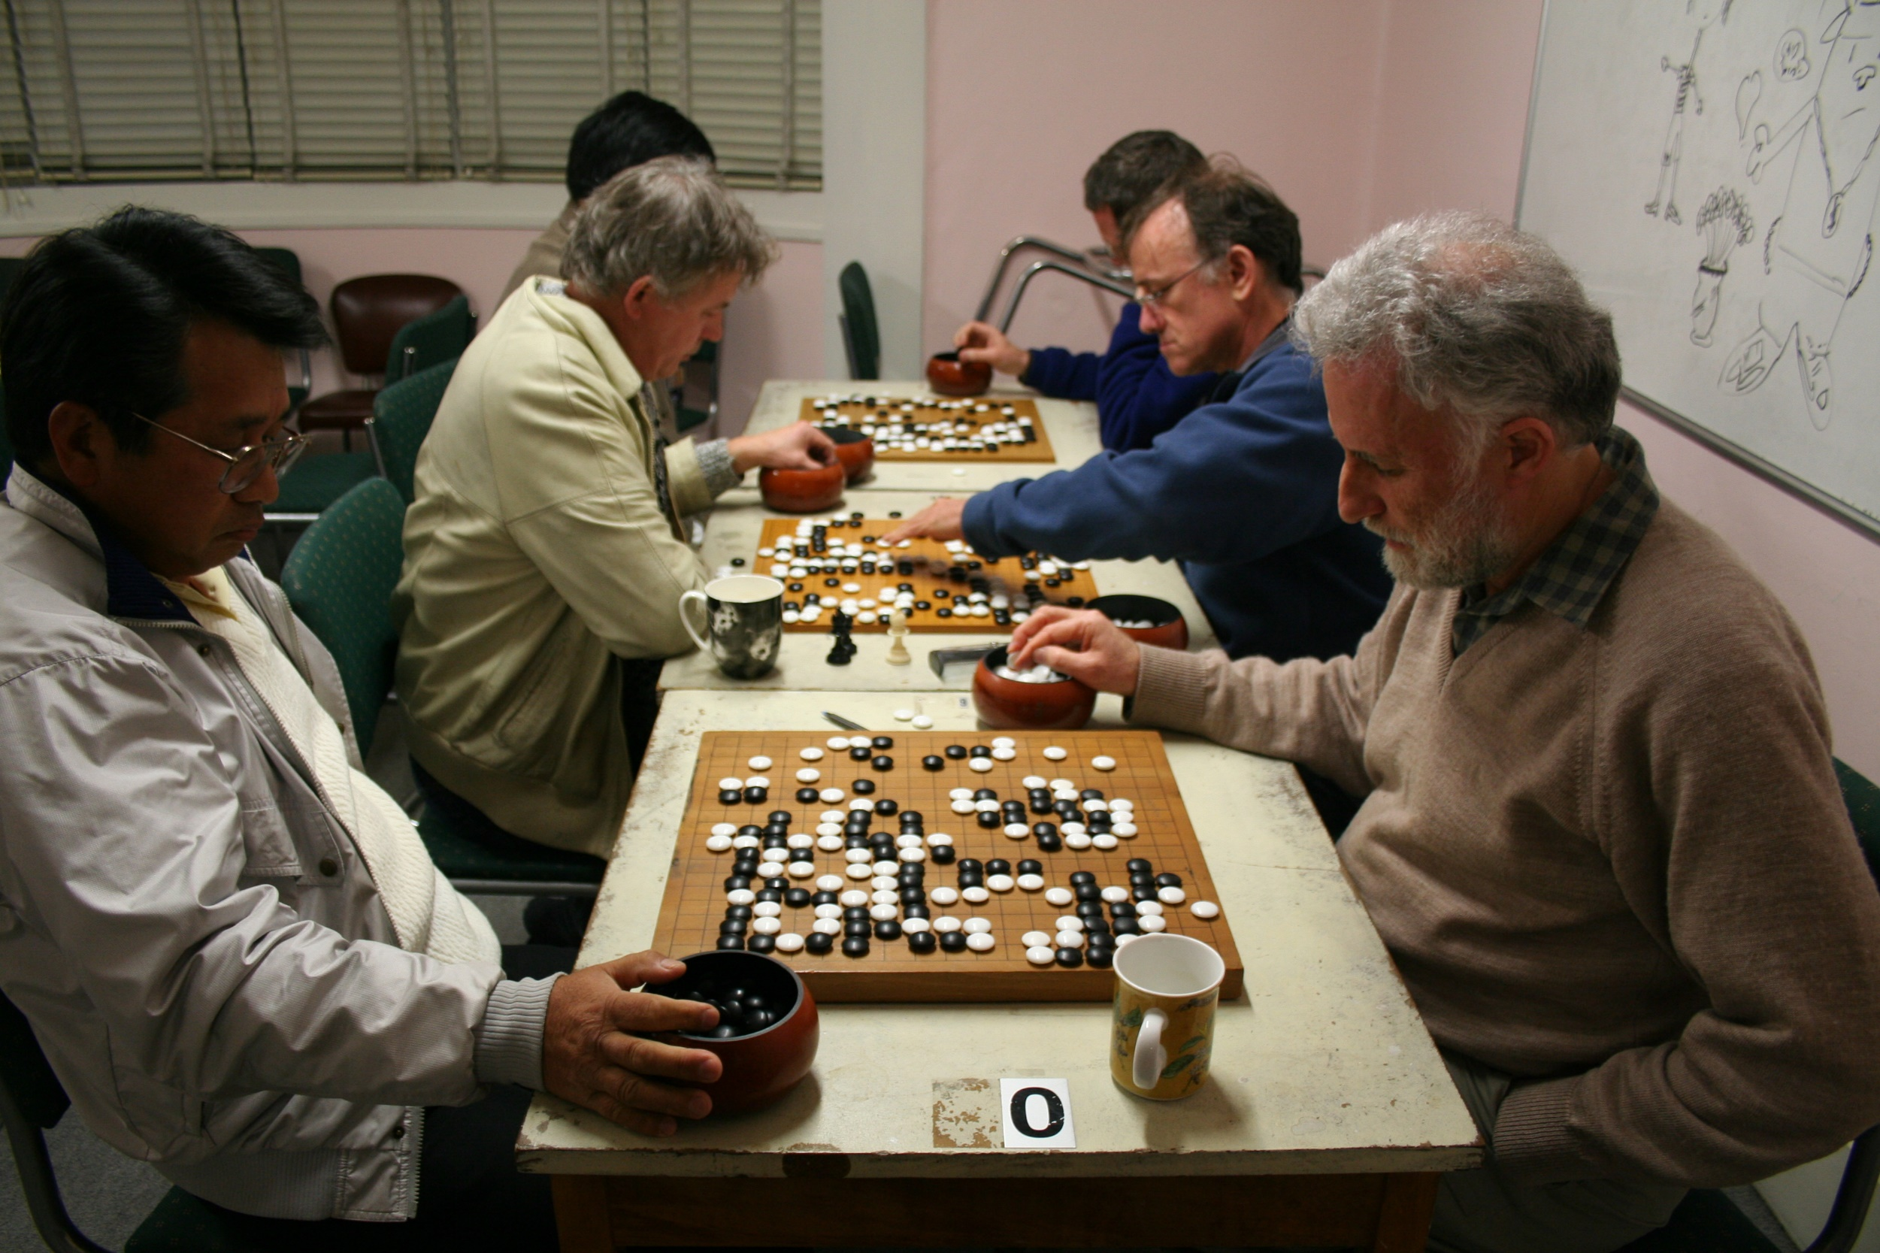

Slide 9
https://www.youtube.com/watch?v=Jq5SObMdV3o

Slide 10
In 2016 Google’s AlphaGo beat Lee Se Dol (18 times world champion).
Go mimics human thought much more than any other game.
AlphaGo trained itself after playing with a bunch of amateurs.
End of the era of Computers vs Humans at Board Games.

Slide 11
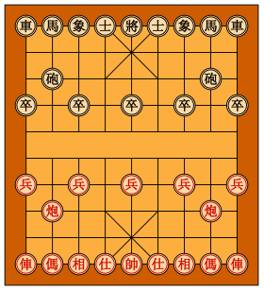
CHINESE CHESS/XIANG QI
CHESS FOR COMMONERS. Differences:-
Played on intersections. (9x10), 16 pcs.
Palace and the River.
King lives in the palace,
Kings cannot face each other directly.
Cannon (pao), must jump to capture.
Soldiers have special moves after River

Slide 12
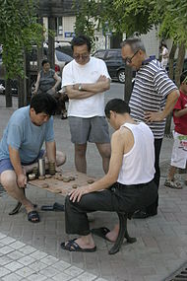
https://www.youtube.com/watch?v=0UuDiL9CLPI

Slide 13
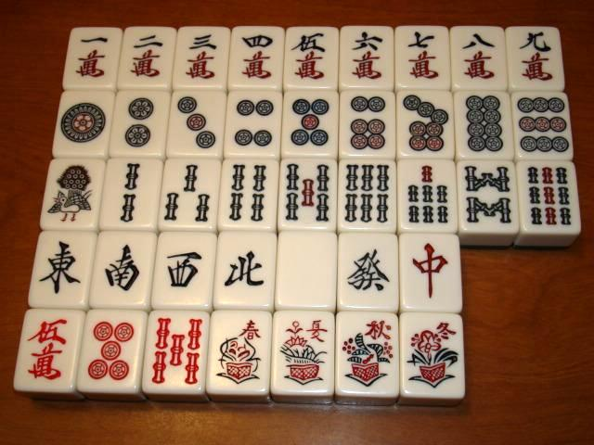
MAH JONG 麻将 (májiàng)

Slide 14
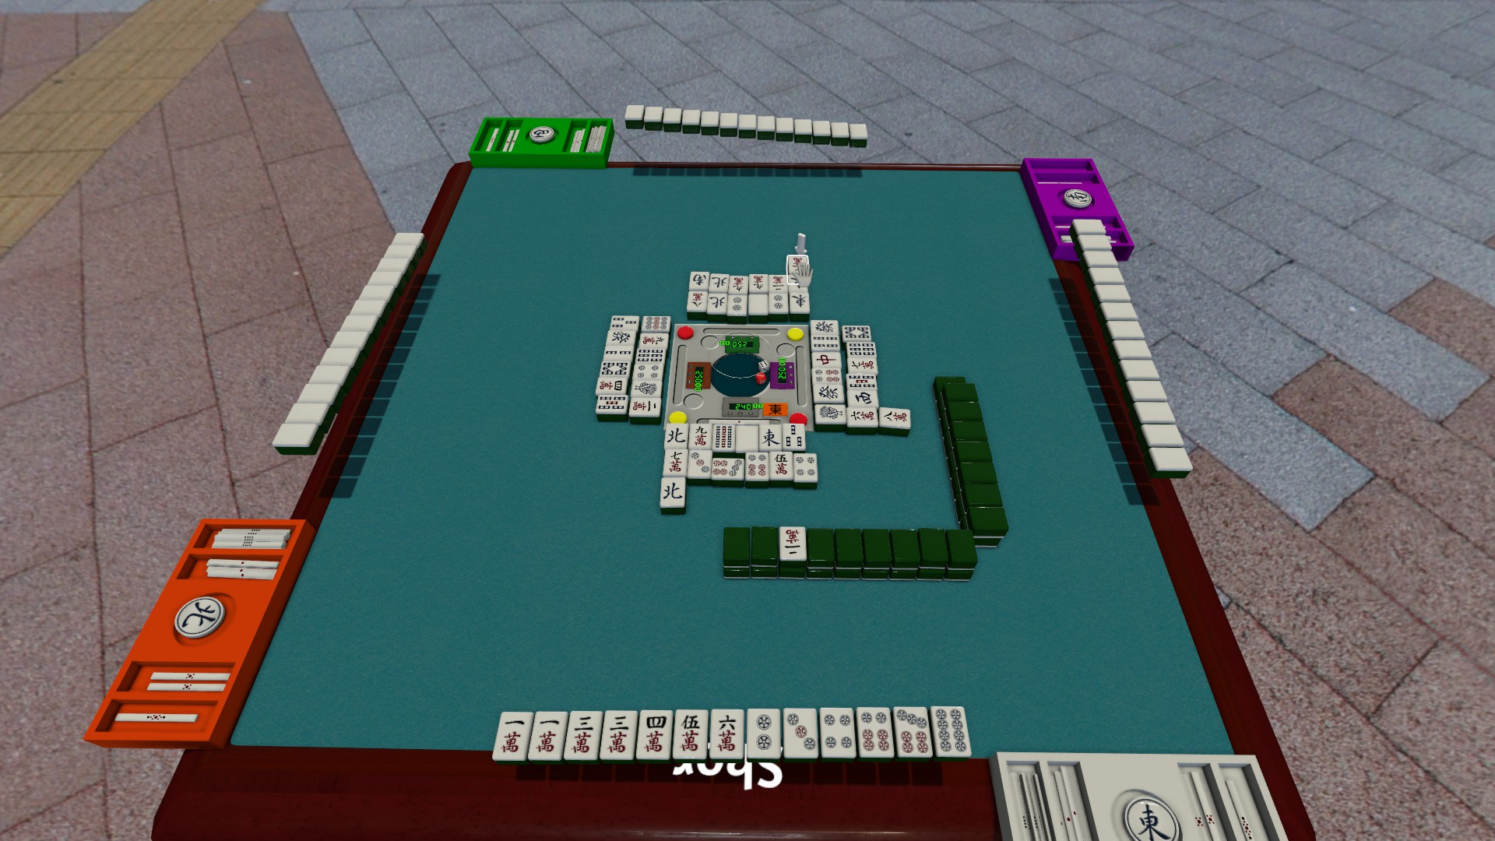
Tile based abstract strategy game.
Played with a set of 144 tiles. (or other combinations).
4 players given 13 tiles each.
Sets and pairs to be completed.
Different styles in various part of Asia.

Slide 15
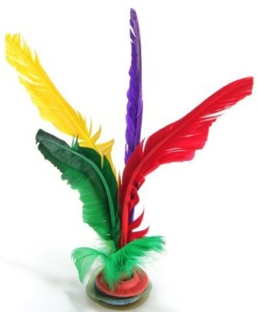
JIAN ZI/CHINESE SHUTTLEOCK
毽子. 2000 YEAR OLD GAME.

Slide 16
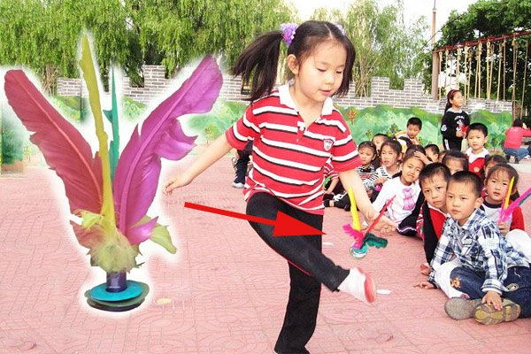

Slide 17
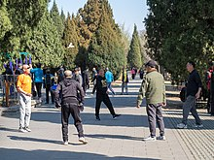

Slide 18
TAI CHI
Also called Internal martial arts.
Health and meditative, besides self defence.
All trace their roots to Chen Family.. Shaanxi to Henan. (1374).
Developed by descendants… adding meditative and medical principles into the movements.
So now you have Taichi for weight loss, Taichi for elders, taichi for expectant mothers etc etc. Gentle and relieves stress.
Benefits have been scientifically documented. Like yoga.

Slide 19
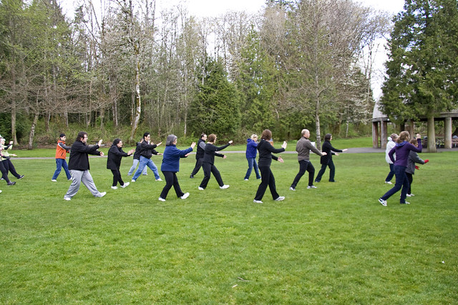
https://www.youtube.com/watch?v=eaIPXs11xIM&list=RDQMBHBfEgumlBM&index=4

Slide 20
CRICKET FIGHTING
CRICKETS ARE TERRITORIAL INSECTS.
Crickets are specially prepared for fights. It is not uncommon for a male cricket to be provided with females prior to a fight in order to rouse up his aggressive spirit.
斗蛐蛐 (DÒU QŪ QŪ).
EXTREMELY POPULAR SPORT. DATES BACK TO TANG FOR KEEPING AS PETS AND TO SONG FOR FIGHTS.
The night before a tournament, many owners feed their cricket a special maggot, and treat it to an herbal spray.
There is a complex method for weighing crickets and judging matches
https://www.youtube.com/watch?v=7sRQGlpCPNY

Slide 21
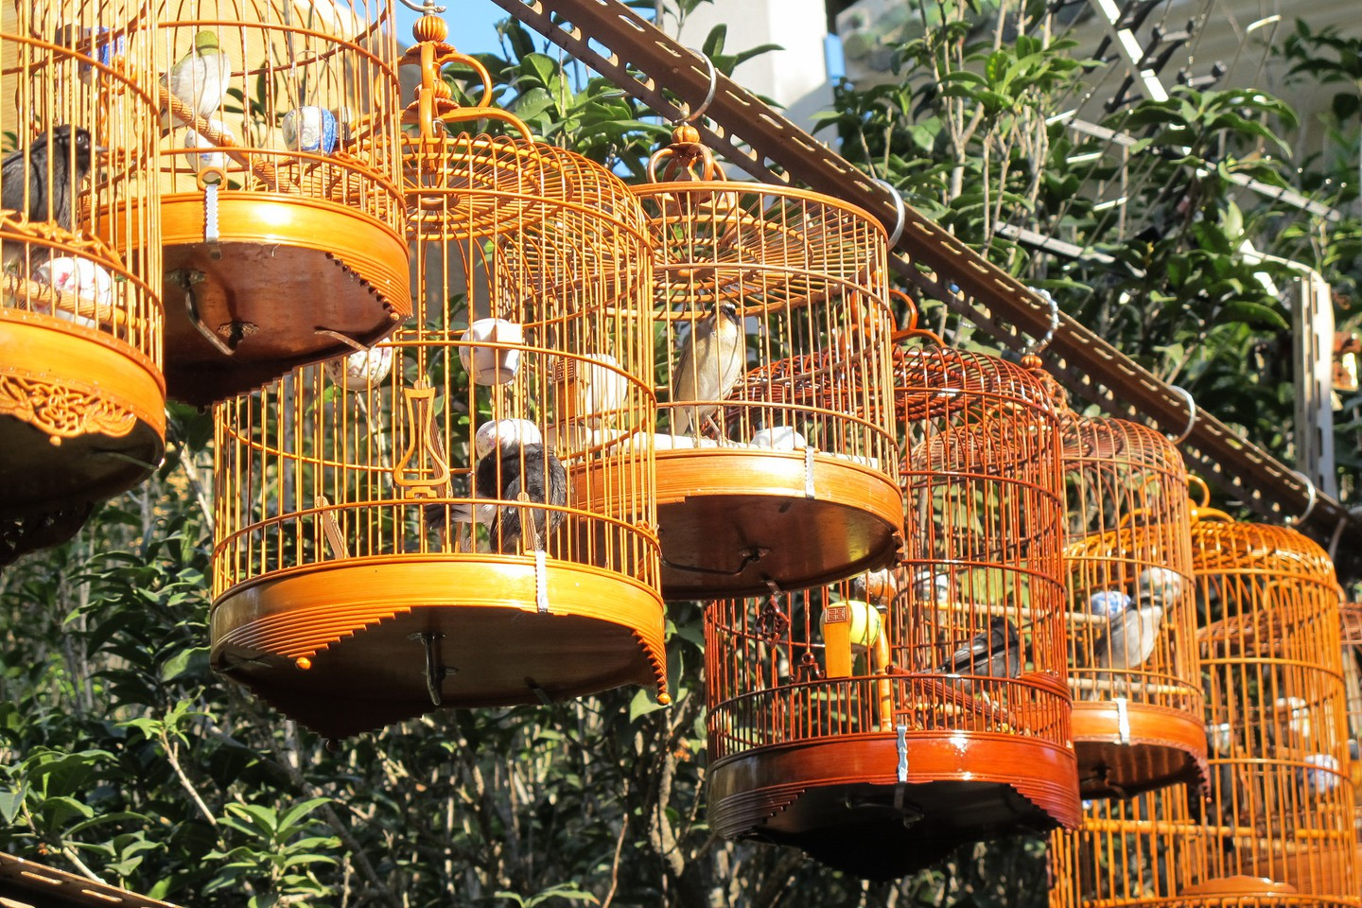
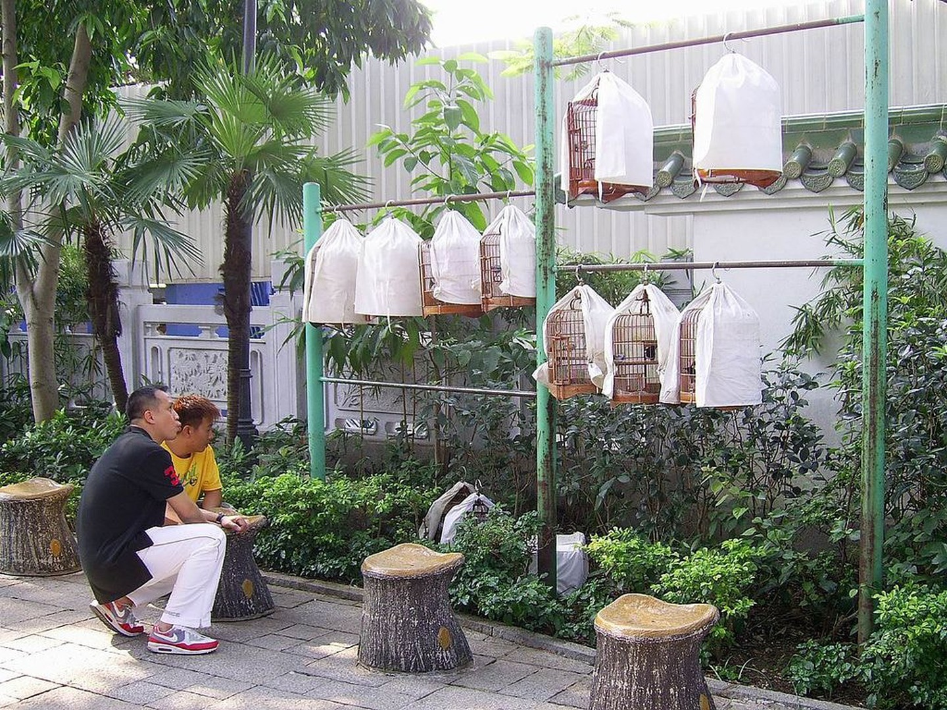
KEEPING PET BIRDS
Ancient. Amazing. Songbirds… Thrush, Larks,
People take Birds for a walk (fancy cages) and even free them.

Slide 22
Kite Flying
Since Warring States Period (475- 221 BC).
Initially for military purposes, Signalling, Record Wind Speed and Direction. Decorative later.
Mostly Mythological figures, symbolic (like Zodiac).
Besides paper, Silk is also used.
Plaque at National Aeronautical and Space Museum, Washington DC.
Weifang is called the Kite Capital of the World.
Why. Because Marco polo (1282) wrote that he saw a Manned Flying Kite there!! To assess wind conditions for sailing.
https://www.youtube.com/watch?v=ezFPH9Pna0E

Slide 23
Za ji/ Gymnastics
Chinese Dominate World Gymnastics. 26 Golds at the Olympics.
Li Ning..Prince of Gymnastics. 6 out of 7 Golds in the 6th World cup. Max individual Golds in LA 1984.
Lit the torch at Beijing 2008. many moves are named after him. Married to Chen Yongyan
Chen Yi bing- 4 times world Champion on the rings. 8 World Titles and Three Olympic Golds.
Cheng Fei, Deng LinLin etc etc.
Traditional Gymnastics
https://www.youtube.com/watch?v=E8SL0A5fcD0

Slide 24
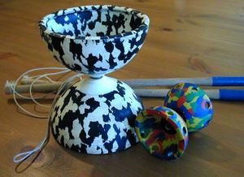
CHINESE YO YO
DIABLO.
MANY NAMES 扯铃 (CHE LING).
https://www.youtube.com/watch?v=v4_AaZwv-mo

Slide 25
Ping Pong/ Ping Pang Qiu
CHINESE ARE VERY GOOD.
VERY POPULAR.
BUT not a Chinese invention.

Slide 26
Thank You

